Slide 1
TRIVIA 101
Ulemu Mwenye

Slide 2
Project description
The Trivia Quiz Game offers an engaging opportunity to put your knowledge to the test while enjoying a rewarding and entertaining experience. Created with the intention of challenging individuals and promoting continuous learning, the game provides a diverse range of categories for users to select and play from. Explore and expand your knowledge in an interactive and enjoyable manner.

Slide 3
Technical Overview
Architecture:
  High-level design.
Frontend:
  HTML, CSS, and JavaScript.
  Responsive design.
Backend (Future):
  The program is primarily a frontend web application that relies on client-side technologies.
User Interface:
  Basic security measures implemented.
  Ongoing development for advanced security.
Scalability:
  Prepared for potential scalability.
  Strategy for handling increased traffic.
Notes:
High-Level Design:
The architecture outlines the overall structure of the application at a high level. It provides a conceptual view of how different components work together.
2. Frontend:
The frontend of the application is built using HTML, CSS, and JavaScript. These technologies are used to create the user interface and handle user interactions.
Responsive design is implemented, making the application adapt well to different screen sizes and devices.
3. Backend (Future):
Although the current version of the application is primarily a frontend web app, there is a plan to develop a backend in the future. This backend will handle server-side operations, data storage, and more.
4. User Interface:
Basic security measures are implemented in the user interface to protect user data and ensure secure user interactions.
Ongoing development for advanced security implies a commitment to continuously improve the application's security measures.
5. Scalability:
The application is prepared for potential scalability, which means it's designed to handle increased load and traffic efficiently.
There is a strategy in place to address increased traffic, ensuring that the application remains responsive and performs well as it grows.

Slide 4
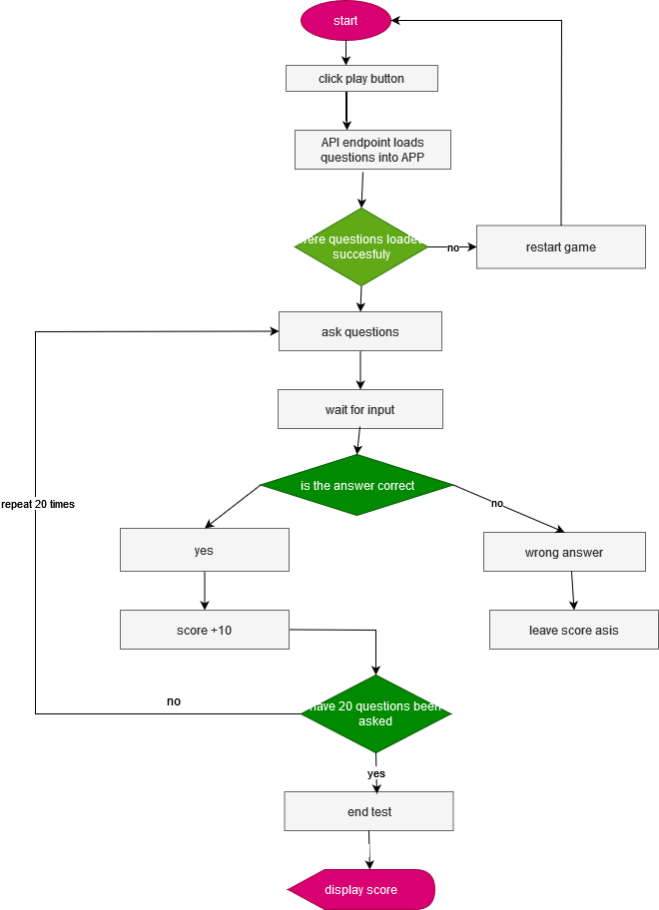

Slide 5
Achievements and Challenges
Successes:
  Functional Quiz App: i successfully created a functional quiz application where users can test their knowledge.
  Responsive Design: The app offers a seamless experience on various browsers due to its responsive design.
  High Scores: Implemented a high score feature where users can submit their scores and compete with others.
  User-Friendly UI: Designed an intuitive and user-friendly interface for a positive user experience.
  Local Storage: Successfully used local storage to store high scores securely.
  Clear Code: Maintained well-structured and readable code for ease of maintenance and collaboration.
  API: THE API provides a constant update on question so it never repeats
  Sweet alerts integration
Challenges:
  Backend Development: A backend for additional features and more secure data storage remains a pending challenge.
  Randomized Questions: Implementing randomized questions and answer options was challenging but vital to the user experience.
  Advanced Security: While basic security measures are in place, enhancing security is an ongoing challenge.
  Database Integration: As i plan for scalability, integrating a robust database system is an upcoming challenge.
  Scalability: We need to ensure that the app can handle increased traffic without performance issues.

Slide 6
Challenges Faced
Of course, no project is without its challenges. i faced a few hurdles, including: Ensuring cross-browser compatibility.
Managing time to finish the project due to work
Managing the the scoreboard.
Implementing data persistence for high scores.

Slide 7
Areas for Improvement
I believe in continuous improvement. Here are areas we're looking to enhance: Exploring multiplayer modes for more interaction.
Expanding the number of quiz categories.
Providing more detailed feedback for a richer user experience.
Developing a proper backend interface for easier management

Slide 8
github link https://github.com/ulemumwenye/trivia101.git

